Slide 1

Introduction to AWS Global Accelerator
S V C 2 1 1
Matt Lehwess
Principal Solutions Architect Amazon Web Services

Slide 2

What does an application deployment look like?
From a customer’s perspective, with the focus on networking, of course…

Slide 3


Let’s take a closer look
The Internet
AWS Region
Amazon S3
Amazon DynamoDB
AWS Lambda
Amazon SQS Amazon SNS
AWS IOT
Amazon EC2
Availability zone 1
Availability zone 2
AWS Region
Public subnet
Instance A
10.1.0.11/24
Public subnet
Instance B
10.1.1.11/24
Amazon VPC
Private subnet
Instance C
10.1.2.11/24
Private subnet
Instance D
10.1.3.11/24
VPC CIDR 10.1.0.0/16

Slide 4














Let’s do a tiny bit of routing
The Internet
AWS Region
Amazon S3
Amazon DynamoDB
AWS Lambda
Amazon SQS
Amazon SNS
AWS IOT
EIP - 10.1.0.11 : 54.23.12.43
EIP - 10.1.1.11 : 54.19.12.23
Elastic IPs
IGW
Availability Zone 1
Availability Zone 2
Destination 10.1.0.0/16
0.0.0.0/0
Target Local IGW
Public subnet
Public subnet
Instance A
10.1.0.11/24
Instance B
^{NAT} 10.1.1.11/24
NAT-GW
Destination 10.1.0.0/16
0.0.0.0/0
Target Local
Private subnet
Private subnet
Instance C
10.1.2.11/24
Instance D
10.1.3.11/24
NAT-GW
Instance B
VPC CIDR 10.1.0.0/16
+ Expand + IPv6

Slide 5






Let’s do a tiny bit of load balancing
The Internet
AWS Region
NLB Example:
Amazon S3
Amazon DynamoDB
AWS Lambda
Amazon SQS
Amazon SNS
AWS IOT
mattsLB-1b7efe83.elb.us-east-1.amazonaws.com
EIP - 10.1.0.11 : 100.26.116.114
EIP - 10.1.1.11 : 3.210.87.216
Address: 100.26.116.114
Address: 3.210.87.216
IGW
Elastic IPs
One IP Elastic IP per AZ
Availability Zone 1
Availability Zone 2
Public subnet
Public subnet
10.1.0.11
10.1.1.11
NLB
Private subnet
Private subnet
Instance C
10.1.2.11/24
Instance D
10.1.3.11/24
VPC CIDR 10.1.0.0/16
+ Expand + IPv6

Slide 6



Cool, let’s take this thing global
Okay…

Slide 7
Amazon Global Network
The AWS Cloud spans:
180 Points of Presence 66 availability zones
21 geographic regions around the world*
Redundant 100 GbE network
Private network capacity between
all AWS Regions, except China
*with announced plans for 12 more availability zones and four more regions in Bahrain, Cape Town, Jakarta, and Milan.

Slide 8






















Why have a backbone network?
Reliable performance
Connecting closer to customers
Security
Availability
* except within the People’s Republic of China

Slide 9


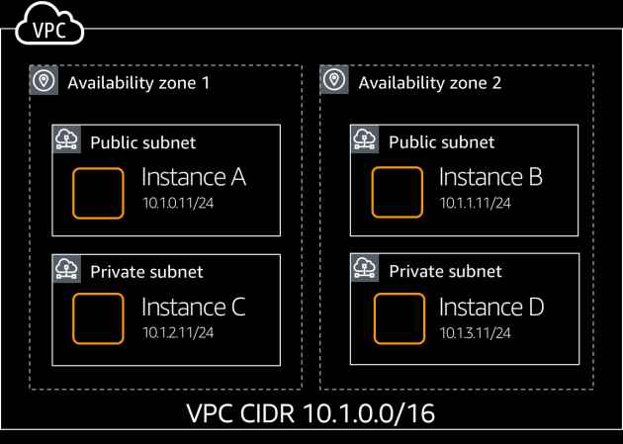
Single region deployment

Slide 10


Single region deployment

Slide 11
Single region deployment

Slide 12
Multi-region deployment

Slide 13






Global traffic management – before
2.3.4.5
1.2.3.4
3.4.5.6

Slide 14




Global traffic management – before
2.3.4.5
Cache
1.2.3.4
www.example.com
1.2.3.4
3.4.5.6

Slide 15


Global traffic management – before
2.3.4.5
Cache
1.2.3.4
www.example.com
1.2.3.4
3.4.5.6
2.3.4.5

Slide 16







What challenges are customers facing today?

Slide 17



Introducing AWS Global Accelerator
Client
AWS Applications

Slide 18



Introducing AWS Global Accelerator
availability
performance
Client
Global Accelerator
AWS Applications

Slide 19
AWS Global Accelerator – How it works
2.3.4.5
1.2.3.4
3.4.5.6

Slide 20


AWS Global Accelerator – How it works
54.86.52.59
Cache
54.86.52.59
www.example.com
54.86.52.59
54.86.52.59
54.86.52.59

Slide 21

AWS Global Accelerator – How it works
54.86.52.59
52.45.82.211
Cache
54.86.52.59
52.45.82.211
www.example.com
54.86.52.59
52.45.82.211
54.86.52.59
52.45.82.211
54.86.52.59
52.45.82.211

Slide 22

AWS Global Accelerator – How it works
All clients point to the same static IPs and are directed to the closest PoP
Global Accelerator endpoint with anycast IP e.g., 54.86.52.59

Slide 23
AWS Global Accelerator – How it works
All clients point to the same static IPs and are directed to the closest PoP
Global Accelerator endpoint with Anycast IP e.g., 54.86.52.59

Slide 24
AWS Global Accelerator – How it works
Instant failover to next closest available AWS Region
Global Accelerator endpoint with anycast IP e.g., 54.86.52.59

Slide 25















Taking a closer look
AWS Region 1
AWS Region 2

Slide 26















3.10.3.125
3.10.3.125
AWS Region 1
AWS Region 2

Slide 27

What are some of the key features?
AWS Global Accelerator

Slide 28



















Key features
1

Slide 29


Before Global Accelerator…
Local ISP
Network A
B
C
D
E
F
Accessing your application is not this straightforward!
It can take many networks to reach the application Paths to and from the application may differ
Each hop impacts performance and can introduce risk

Slide 30

With Global Accelerator…
Local ISP
AWS Network
Traffic enters AWS global network at edge locations Leverages the Global AWS Network Resulting in improved performance

Slide 31


Choosing an endpoint…
AWS Global Accelerator

Slide 32










Endpoint selection
Geo-proximity
Client affinity settings
Customer-configured policies
Application Health

Slide 33








Traffic Control – Optimal endpoint selection
Region : us-west-1
Region : us-west-1
5 Tuple
Protocol: UDP/TCP
Src IP: 1.2.3.4
Src Port: 32759
Dest IP: 5.6.7.8
Dest Port: 80
Optimal region
Hash (5 tuple)

Slide 34


Traffic Control – Client Affinity
Region : us-west-1
ELB
Region : us-west-1
2 Tuple
Protocol: UDP/TCP
Src IP: 1.2.3.4
Src Port: 32759
Dest IP: 5.6.7.8
Dest Port: 80
Optimal region
Hash (2 tuple)

Slide 35






Easy Traffic Control – Regional Traffic dials
Region : us-east-1
ELB
Region : us-west-1
Dial values: Min 0%; Max 100%; Default 100%

Slide 36





Easy Traffic Control – Regional Traffic dials
Region : us-east-1
ELB
Region : us-west-1
Dial values: Min 0%; Max 100%; Default 100%

Slide 37











Easy traffic control – Endpoint Weights
Region : us-east-1
ELB
Region : us-west-1
Weights values: Min 0; Max 255; Default 128

Slide 38

Health Checks
Region : us-east-1
ELB
Region : us-west-1

Slide 39

Health Checks
Region : us-east-1
ELB
_{X}ELB
Region : us-west-1

Slide 40

So how do we configure AWS Global Accelerator
Ease of use….

Slide 41




Accelerator configuration
Network Zone A
Network Zone B
1.2.3.4
3.4.5.6
TCP 80,443
UDP 53
 |  | us-east-1 Endpoints: ALB 1,
 |  | ALB 2
 |  | eu-west-1 Endpoints: NLB 1,
 |  | NLB 2

Slide 42
Console workflow
Demo!

Slide 43
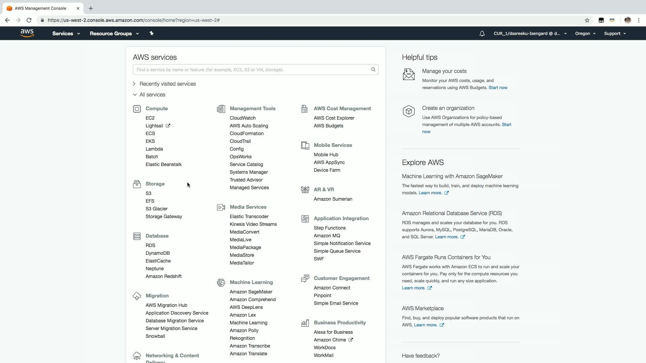
AWS Global Accelerator - Console workflow

Slide 44
Intelligent routing demo
Another demo!

Slide 45
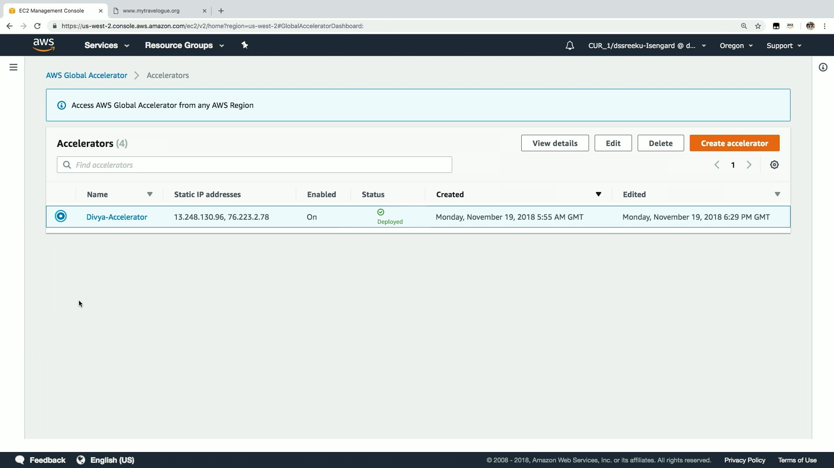
AWS Global Accelerator - Intelligent routing demo

Slide 46

How to architect for high availability
AWS Global Accelerator

Slide 47










Strengthen your availability posture

Slide 48











Global Accelerator – Fault-isolating design
192.0.2.0/24
198.51.100.0/24
Anycast BGP announcements
Under the hood
Network Zone A
Network Zone B

Slide 49


DDoS protection at edge
AWS Shield
Client traffic
AWS Global Accelerator
AWS Applications
DDoS traffic
S U M M I T

Slide 50
Pricing
$$$

Slide 51






AWS Global Accelerator – Pricing
Fixed Fee
Data Transfer – Premium
 |  | Destination (AWS edge locations)
 |  | US & Canada | Europe | Asia Pacific | South Korea | India | Australia
Source (AWS Regions) | US & Canada | $0.015 | $0.015 | $0.035 | $0.035 | $0.035 | $0.105
 | Europe | $0.015 | $0.015 | $0.043 | $0.035 | $0.033 | $0.105
 | Asia Pacific | $0.012 | $0.043 | $0.010 | $0.058 | $0.032 | $0.080
 | South Korea | $0.017 | $0.020 | $0.043 | $0.043 | $0.067 | $0.080
 | India | $0.025 | $0.023 | $0.023 | $0.072 | $0.023 | $0.094
 | Australia | $0.070 | $0.070 | $0.074 | $0.091 | $0.101 | $0.007

Slide 52


Why would I use AWS Global Accelerator?

Slide 53
Use Cases – When to use Global Accelerator
IP whitelisting
UDP Traffic
Gaming
Telco – Voice over IP (VoIP)
Live Video ingest
Media
Automotive / Connected vehicles
Retail / Payments transactions
Healthcare
IOT
Telco – DNS

Slide 54
Use Cases – When to use Global Accelerator
Multi-region applications
API Acceleration
Financial Services
DR / Failover for applications
Media
Ad-tech
Strong value proposition for critical and latency-sensitive internet-facing use cases

Slide 55

Who is using AWS Global Accelerator today?

Slide 56




Use Case: Live Video Ingest
AWS Region
Global Accelerator (AWS edge)
Clients around the world
Transcoding clusters
“Our video platform is hosted on AWS and uses Global Accelerator to improve the performance and availability of video ingest for our users all around the world”
—Erik Viklund, VP Dev Ops, Flowplayer

Slide 57


Use Case: IP whitelisting + API acceleration
AWS Region
Data around products, prices, built-in loyalty programs, and personalized menu configurations
$$$
Global Accelerator (AWS edge)
Point of Sales in restaurants
Brink POS Software
“All our Points of Sale use AWS Global Accelerator to reach our applications running on AWS with high availability and low latency”
—Leonard Redles, System Architect, ParTech, Inc.

Slide 58






Use Case: Voice over IP
AWS Region
Mobile Device
Global Accelerator (AWS edge)
Global Accelerator (AWS edge)
Mobile Device
RTP Engine
“We leverage AWS Global Accelerator’s static anycast IPs and global network to handle Voice over IP (VoIP) traffic, thus ensuring that our customers get the best quality of service”
—Marcin Kowalczyk, AWS Architect, CrazyCall

Slide 59
What this means for you…

Slide 60
AWS Global Accelerator
Anycast IP
Helps create a more robust architecture
Increases network stability
Provides automatic health checking and routing
www.example.com 1.1.1.1

Slide 61









Health checks and traffic control
AWS Global Backbone
Region : us-east -1
ELB
Region : us-west-1

Slide 62

Thank you!
Matt Lehwess mattyloo@amazon.com
S U M M I T
© 2019, Amazon Web Services, Inc. or its affiliates. All rights reserved.

